Slide 1
EagleSat 2 – Program Overview
Presented by: Hilliard Paige – Project Manager
In cooperation with: Dr. Gary Yale, Lauren Barthenheier, Jason Hamburger, David Stockhouse, Steven Buck, and Chloe McClellan
27th Arizona Space Grant Symposium
Tuscon, Arizona
April 14th 2018

Slide 2
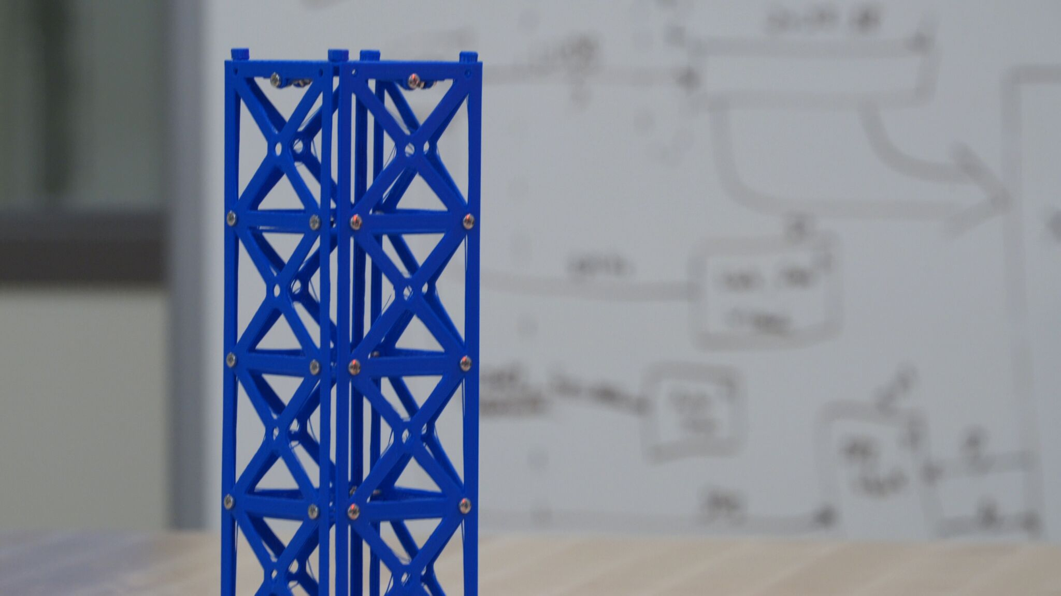
Outline
Mission Overview
Current Configuration
2017-2018 Developments
Challenges
Upcoming Schedule

Slide 3
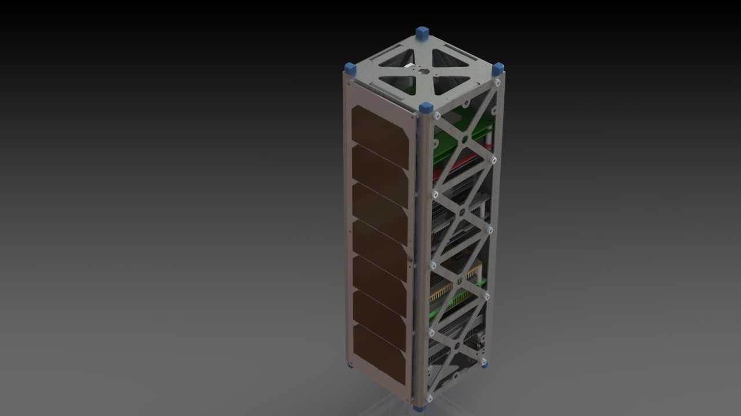
Mission Overview
Scientific Goals
Spacecraft – 3U CubeSat
SELECTED - 2018 NASA CubeSat Launch Initiative
Designing for ISS orbit
  402-424 km
  51.6 degree inclination

Slide 4
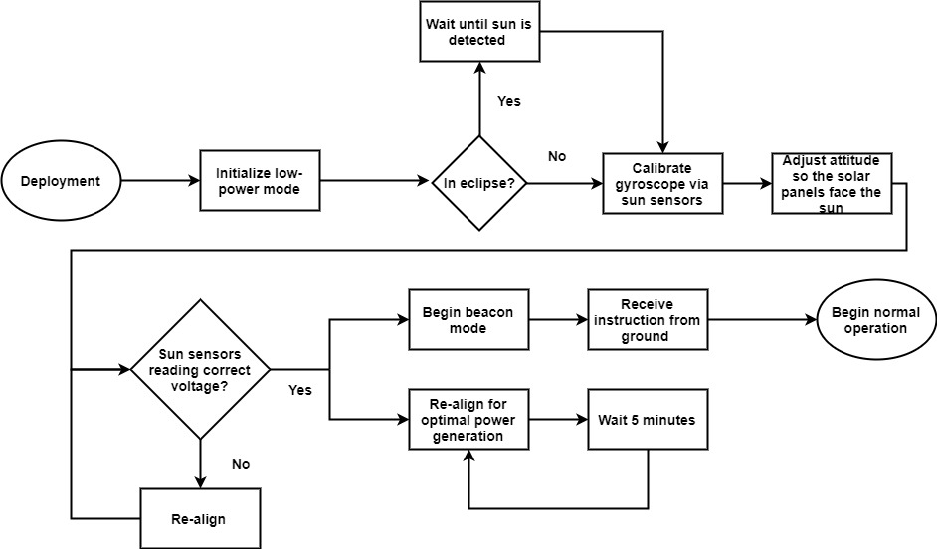
Mission Overview: Deployment & Activation

Slide 5
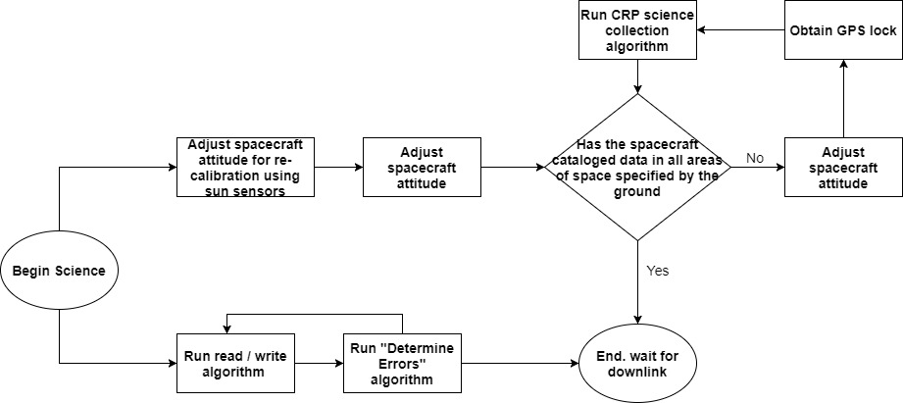
Mission Overview: Standard Operation

Slide 6
“Current” Configuration
Notes:
Power margins will be discussed in more detail with laurens presentation

Slide 7
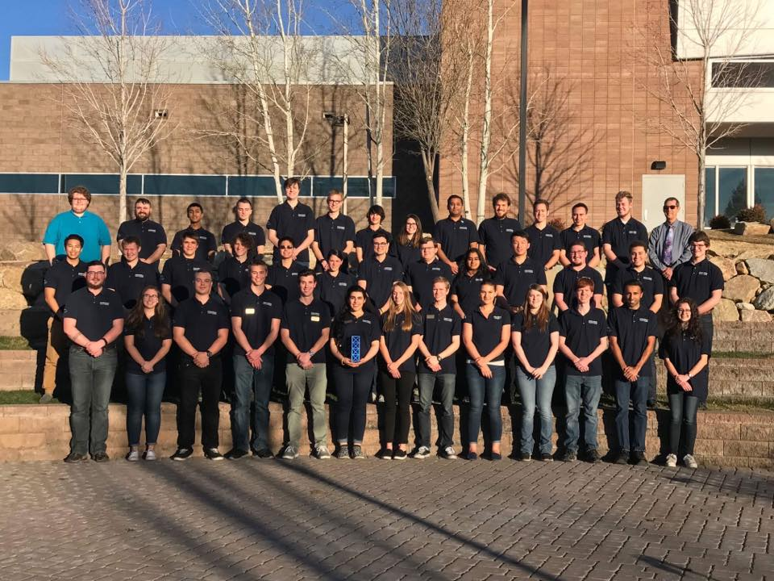
Purpose and Benefits
Education
Strong, achievable scientific goals
Commercially available bus systems
Work with teams, departments, and organizations both on and off campus

Slide 8
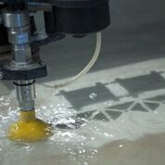
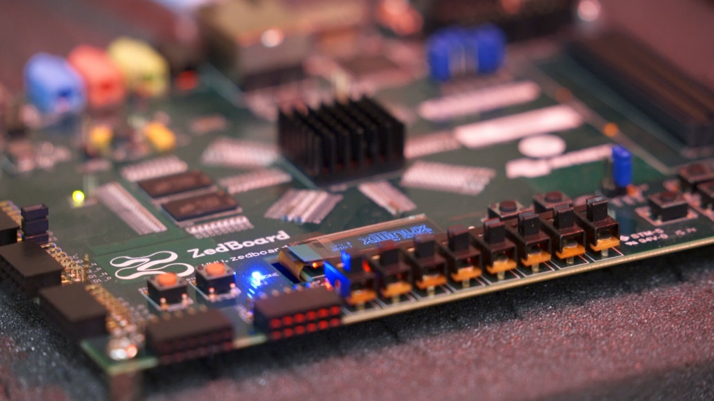

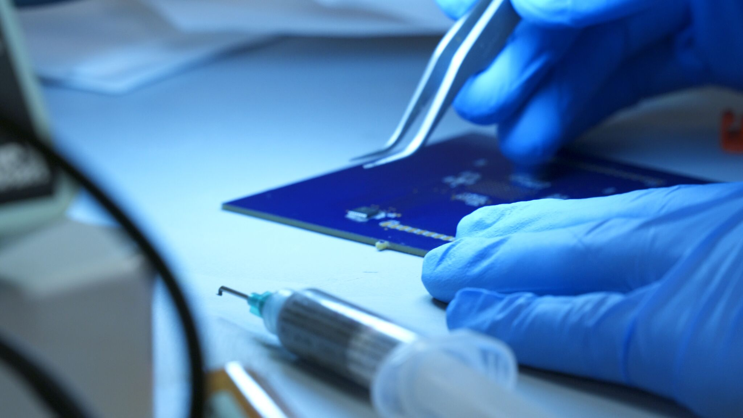
Development Progress (last12 months)
Finalized design pre-PDR
Fielded comments from PDR, changed design where necessary
Applied to NASA CSLI → Accepted → 3rd out of 15
Finalized bus system design
Created working models of both payloads (developmental)
Extensive payload testing

Slide 9
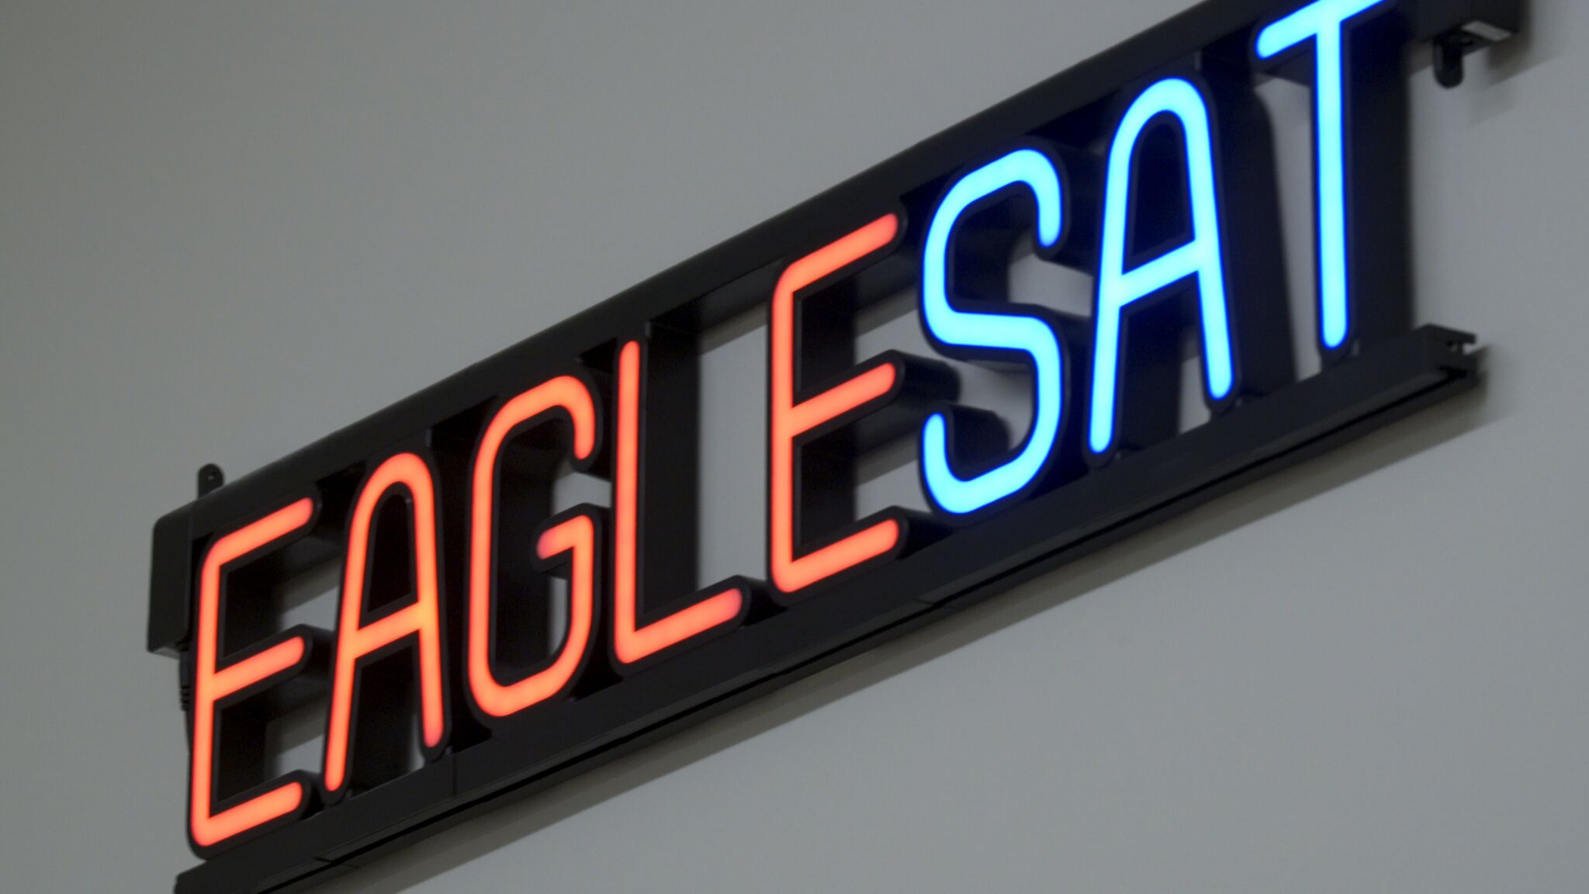
Current Issues
Hardware
  CRP PCB production and tolerancing
  LVDS interface
  Reflow oven
  TVAC
Schedule
  Currently behind schedule 1-2 weeks
  Looking to make up some time over summer
Programmatic
  Funding constraints
  Student turnaround
  Misc.

Slide 10
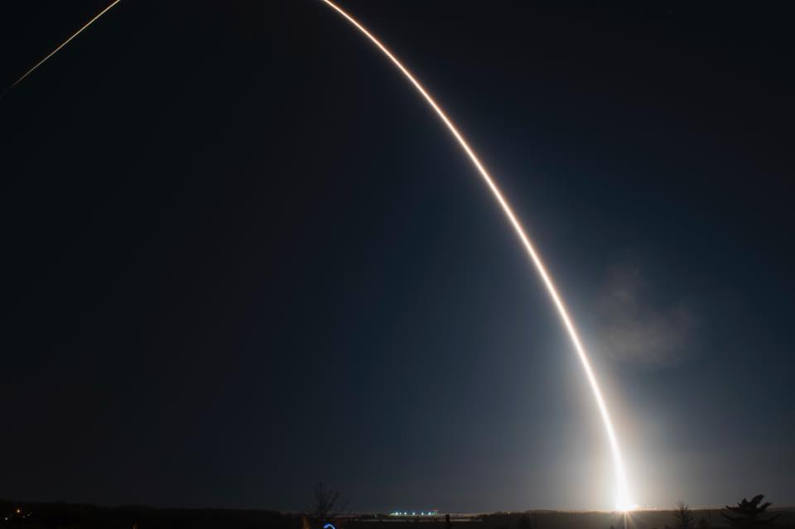
Looking Forward
Continue & finalize payload development
Continue hardware procurement
Long-term payload radiation testing
Establish a working relationship with ASU Phoenix
CDR
CSLI Manifest

Slide 11
Acknowledgements
Dr. Gary Yale, ERAU
Dr. Ronald Madler, ERAU
Travis Imken, JPL
Jim Weber, ERAU
Jeff Hyatt, ERAU
Arizona Space Grant
NASA CSLI

Slide 12
Conclusion
Development on EagleSat 2 is progressing as planned with estimated completion in 2019-2020
Support from Arizona Space Grant helps greatly in achieving our goals
Next Milestone: CDR, Fall 2018
Questions / Comments: paigeh@my.erau.edu

